Slide 1
EUROPEAN DIGITAL PORTFOLIO FOR UNIVERSITY STUDENTS
European Digital Portfolio for University Students
“The e-Portfolio for all University Students in Europe”
This project is supported by the EU. Any communication or publication related to the Project made by the beneficiaries jointly or individually in any form and using any means, shall indicate that it reflects only the author's view and that the NA and the Commission are not responsible for any use that may be made of the information it contains.

Slide 2
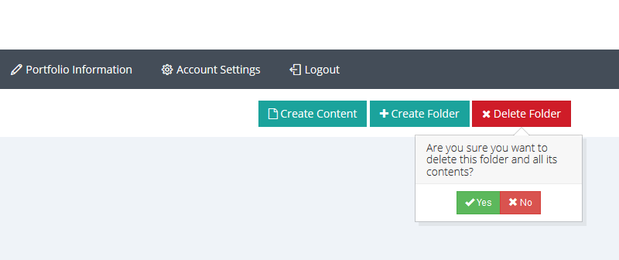
B8. Add/Edit/Delete Category “components”
You cannot delete the prefixed categories.
You allow to delete only the categories that you have created.
This project is supported by the EU. Any communication or publication related to the Project made by the beneficiaries jointly or individually in any form and using any means, shall indicate that it reflects only the author's view and that the NA and the Commission are not responsible for any use that may be made of the information it contains.

Slide 3
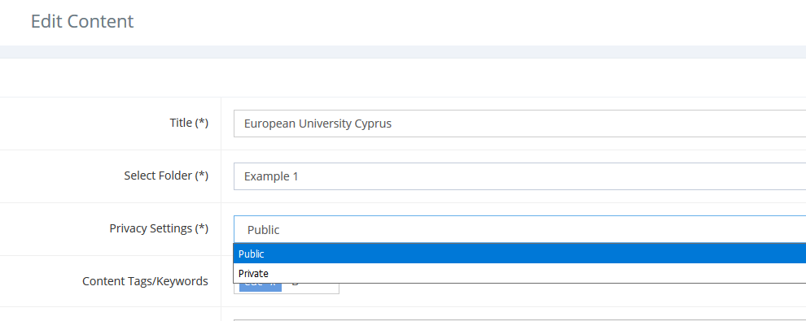
B8. Add/Edit/Delete Category “components”
B8.1. Privacy Settings and Restrictions
When you create new content you have to decide if the content would by Private or Public. This can be done by Privacy Settings.
Public: everyone can see them.
Private: only the user can see them.
This project is supported by the EU. Any communication or publication related to the Project made by the beneficiaries jointly or individually in any form and using any means, shall indicate that it reflects only the author's view and that the NA and the Commission are not responsible for any use that may be made of the information it contains.

